Slide 1
Calculating Price Adjustments Using CPI & PPI

Slide 2
Difference Between CPI and PPI
CPI – Other Goods & Services (Commodities)
CPI – All Items (Services)
PPI – All Commodities
PPI – Specific Commodities
Notes:
First, we’ll discuss the differences between the CPI and PPI indexes.
The State has three standard price adjustment clauses that reference either the CPI or the PPI. In those clauses, we have the following four methods to determine a price adjustment. We’ll look at each of the three clauses and walk through the process of determining the percent difference in each of the four methods listed here.

Slide 3
Difference Between CPI and PPI
CPI
Purchaser’s Perspective
PPI
Seller’s Perspective
Consumption for US Households
Out-of-Pocket Expenditures
Sales & Excise Tax Included
Purchased by Other Producers/Consumers/Exports
Revenue Received by Producer
Sales & Excise Tax Not Included
Notes:
The Producer Price Index is a family of indexes that measures the average change over time in the selling prices received by domestic producers of goods and services. PPIs measure price change from the perspective of the seller. This contrasts with other measures, such as the Consumer Price Index (CPI), that measure price change from the purchaser's perspective.
The target set of goods and services included in the PPI is the entire marketed output of U.S. producers. This includes goods, services, and construction products purchased by other producers as inputs to their operations or as capital investment, goods and services purchased by consumers either directly from the service producer or indirectly from a retailer, and products sold as export and to government.
The target set of items included in the CPI is the set of goods and services purchased for consumption purposes by urban U.S. households.
The price collected for an item included in the PPI is the revenue received by its producer. Sales and excise taxes are not included in the price because they do not represent revenue to the producer. The price collected for an item included in the CPI is the out-of-pocket expenditure by a consumer for the item. Sales and excise taxes are included in the price because they are necessary expenditures by the consumer for the item.
The differences between the PPI and CPI (except for coverage) are consistent with the different uses of the two measures. A primary use of the PPI is to deflate revenue streams in order to measure real growth in output. A primary use of the CPI is to adjust income and expenditure streams for changes in the cost of living.
A simple way to remember the difference is that PPI is typically used for commodities and CPI is used for services.

Slide 4
CPI – Other Goods & Services
Using The BLS Tables

Slide 5
PRICE ADJUSTMENTS – LIMITED BY CPI “OTHER GOODS & SERVICES” (JAN 2006)
Upon request and adequate justification, the Procurement Officer may grant a price increase up to, but not to exceed, the unadjusted percent change for the most recent 12 months for which data is available, that is not subject to revision, in the Consumer Price Index (CPI) for all urban consumers (CPI-U), “Other Goods & Services” for services, as determined by the Procurement Officer. The Bureau of Labor and Statistics publishes this information on the web at www.bls.gov
[07-7B175-1]
Notes:
This is our standard clause for the CPI Other Goods & Services. The important parts of the clause that dictate what we need to look for are highlighted.
Unadjusted percent change
Most recent 12 months
Not subject to revision
For all urban consumers
These items are important because they are going to dictate exactly which report we need to pull from the bureau of labor and statistics website.

Slide 6
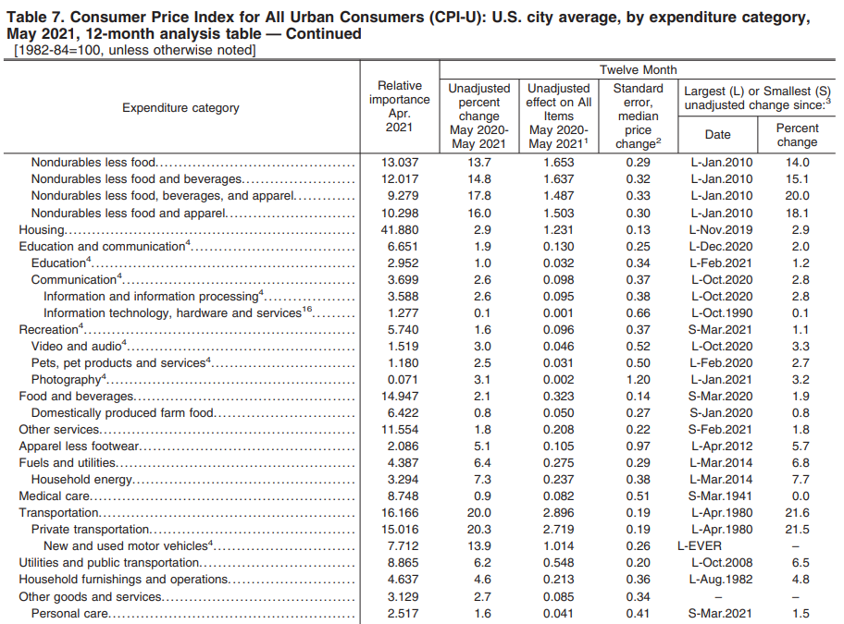
Notes:
The easiest way to determine what the unadjusted percent change for CPI Other Goods & Services, is to use Table 7 of the CPI database. The PDF version of the table is shown here as an example. Later we’ll go through the process of finding this information and doing the calculations to determine the percent change.
Look at the top of the page where the black box is entitled “Unadjusted percent change May 2020-May 2021.” This report will have the most recent completed data so those dates will change from month to month. This data is accurate to the requirements of the previous slide that we must use the same start/end month.
Near the bottom of the page you can see where we highlighted the “Other goods and services line” and specifically, the percent change which in this case is 2.7% between May 2020 and May 2021.

Slide 7
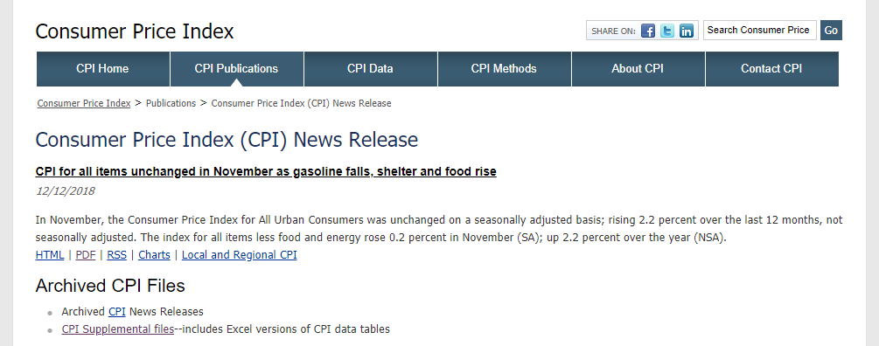
Consumer Price Index (CPI) News Release Access
https://www.bls.gov/cpi/news.htm
Notes:
There are two ways to get to Table 7. The first is using the link on the slide to get to the CPI News Release. This is the most current version of the CPI reports. You can use any of the formats offered by the site but I recommend using the PDF version as it is easy to save as supporting documentation.
Click on “PDF” and a new window will open with the full PDF file.

Slide 8
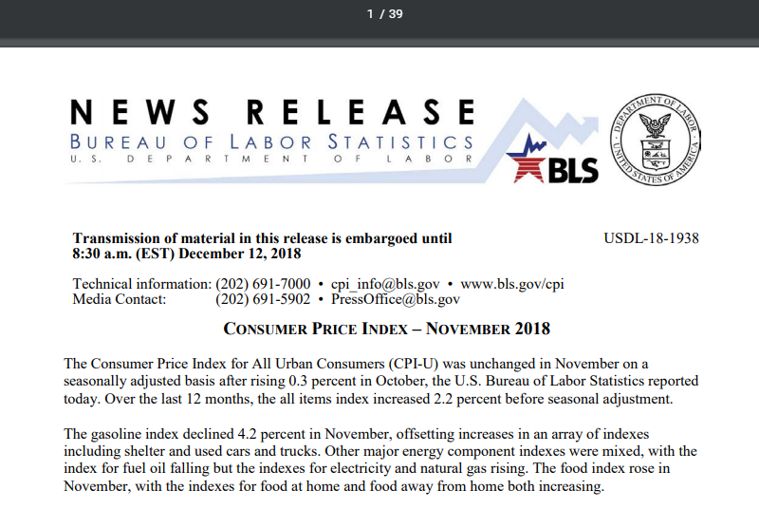
Notes:
This is a screenshot of the first page of the report. Notice at the top of the screenshot that there are 39 pages in this particular report. The “Other goods and services” portion we are looking for is far back in the report. In this example, the Table 7 we saw two slides back was on page 38 of the report and should typically be one of the last entries in the report.

Slide 9
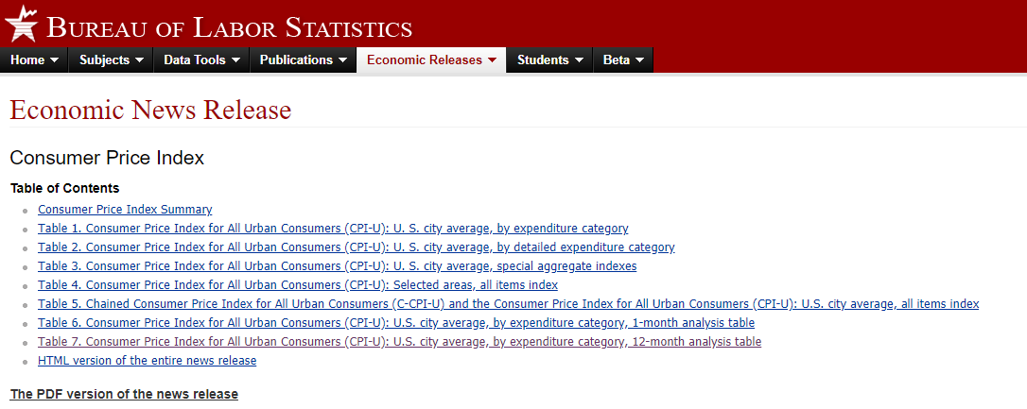
Consumer Price Index (CPI) News Release Access
https://www.bls.gov/news.release/cpi.toc.htm
Notes:
The second method is to use the link on the slide to get to the “Economic Releases” tab of the website. You can see a link for each table of the CPI report on this page and you can go directly to that Table in the report. The link to the PDF version of the report takes you directly to the report we saw earlier.
Clicking on the link for Table 7 will result in a new page opening.

Slide 10
CPI – Other Goods & Services
Manually Determining Percent Change

Slide 11
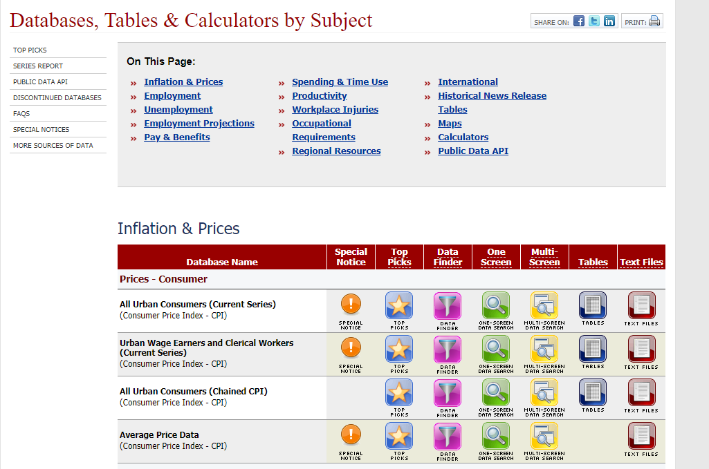
CPI Database Screen
https://www.bls.gov/data/
Notes:
Using the link on the slide, we want to go to the CPI Databases.
On that page we’ll see this table of databases. Using the “All Urban Consumers” line (as dictated by our clauses) we want to click on the “One-Screen Data Search” button.

Slide 12
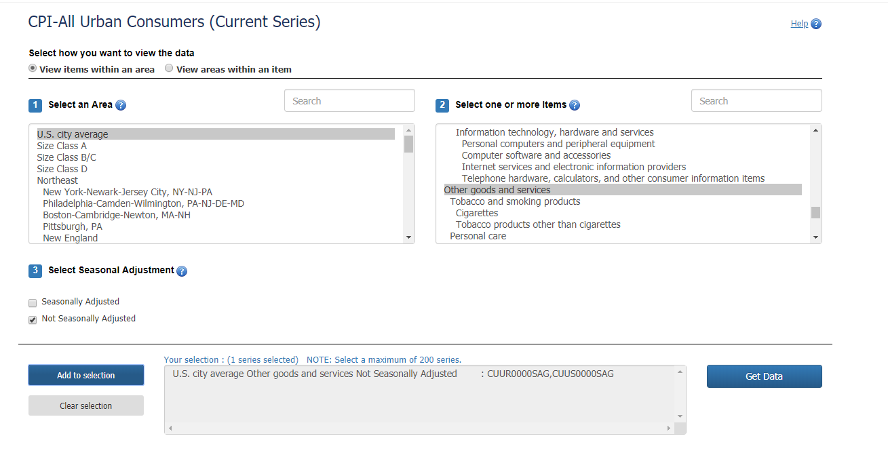
CPI Database Search
Notes:
That brings up this screen and we are going to enter our search data in to these three parts to get the data table we are looking for.
In Area 1, we are going to select “US city average.”

Slide 13
CPI Database Search
Notes:
In Area 2, we are going to scroll down until we find “Other goods and services.” Notice the circle on the right. Just like with the Table 7 reports, the other goods and services we want is near the end of the selection list, so we need to scroll down until we get to that reference.
You can also enter a search term for this area to try and narrow down the items listed.

Slide 14
CPI Database Search
Notes:
Under Area 3 we are going to do two things. First we are going to make sure that “Seasonally Adjusted” is NOT checked. Remember that our clause states “unadjusted percent change” so we to make sure we include that in our report.

Slide 15
CPI Database Search
Notes:
The second thing we are going to do in Area 3 is to click on the “Add to selection” button.

Slide 16
CPI Database Search
Notes:
Clicking on the “Add to selection” button will populate the middle window, which until now has been blank, with the report that you are going to run. You can see in the title of the report that your selections are confirmed; this is a good way to double check what you are looking for.

Slide 17
CPI Database Search
Notes:
Once you are sure you have the report you want to run, click on the “Get Data” button to run the report.

Slide 18
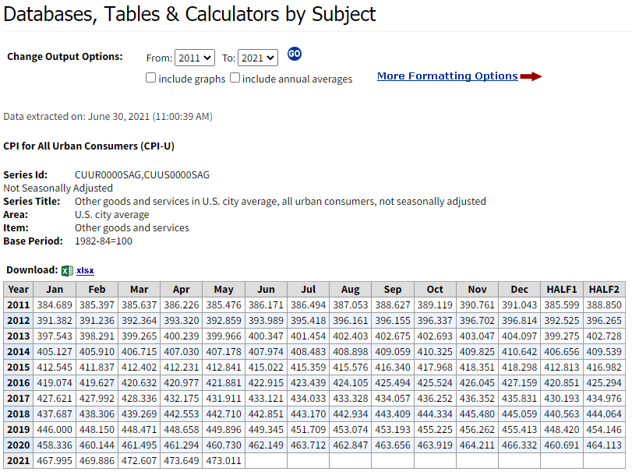
CPI 12 Month Percentage Change Report
Notes:
This is what the report looks like once you click on the “Get Data” button. Notice in the header that once again the system is clarifying the type of report, and in the “Series Title” line is confirming the data you selected earlier.
Using the CPI Data Table 7 is good if you need the current report. This report is better if you need to manually calculate the percent change for something other than the current report. For example, a vendor requests a price adjustment in November, and you forget to process it until they remind you in January.

Slide 19
PRICE ADJUSTMENTS – LIMITED BY CPI “OTHER GOODS & SERVICES” (JAN 2006)
Upon request and adequate justification, the Procurement Officer may grant a price increase up to, but not to exceed, the unadjusted percent change for the most recent 12 months for which data is available, that is not subject to revision, in the Consumer Price Index (CPI) for all urban consumers (CPI-U), “Other Goods & Services” for services, as determined by the Procurement Officer. The Bureau of Labor and Statistics publishes this information on the web at www.bls.gov [07-7B175-1]
*Based on when the price increase request is made by the vendor.
Notes:
Something we haven’t discussed yet is what the most recent 12 months means. We need to base that off when the vendor makes the request. For example, if the request is made in July, then we need to calculate the most recent 12 months starting with July and working our way backwards. In our example in this part, we are using June 2021 as when we received the request from the vendor.

Slide 20
How to Calculate % Change
https://www.bls.gov/cpi/factsheets/cpi-math-calculations.pdf
Notes:
Before we begin to do our calculations, we need to understand that this is important and must be consistent throughout all CPI/PPI evaluations.
In order to have an accurate over-the-year percent change, you must always use the same starting/ending month. In this example, they use May 2015 and May 2016. This reference is from the BLS website and applies to both CPI and PPI calculations.

Slide 21
CPI 12 Month Percentage Change Report
Notes:
Here we have identified the “12 months” that we will use in our calculation.

Slide 22
12 Month Percentage Change Formula
Percent Change = [(new value – original value) / original value] * 100
The difference between Month 12 (May 2021) – Month 1 (May 2020), divided by Month 1 (May 2020) * 100
Example
473.011 – 460.730 = 12.281
12.281 / 460.730 = .0266 * 100 = 2.66 OR 2.7%
The CPI for the most recent twelve-month period not subject to revision is 2.7%. Compare this to the CPI Table 7 data of a 2.7% change for the same period.
Notes:
Here we have the formula that we will use to determine the percent change. (READ SLIDE AND ELABORATE)

Slide 23
CPI – All Items
Manually Determining Percent Change
Notes:
The CPI Table 7 is also a good reference for the CPI All Items, it is the very first entry in Table 7. We’ll do the manual calculation in this portion.

Slide 24
PRICE ADJUSTMENTS – LIMITED BY CPI “ALL ITEMS” (JAN 2006)
Upon request and adequate justification, the Procurement Officer may grant a price increase up to, but not to exceed, the unadjusted percent change for the most recent 12 months for which data is available, that is not subject to revision, in the Consumer Price Index (CPI) for all urban consumers (CPI-U), “all items” for services, as determined by the Procurement Officer. The Bureau of Labor and Statistics publishes this information on the web at www.bls.gov
[07-7B170-1]
*Based on when the price increase request is made by the vendor.
Notes:
As a reminder, here is our clause with the important parts highlighted.
Unadjusted percent change
Most recent 12 months
All urban consumers
All items for services

Slide 25
CPI Database Screen – All Items
https://www.bls.gov/data/
Notes:
We’re back at our CPI database screen and we’re going to select the “One Screen Data Search” button again.

Slide 26
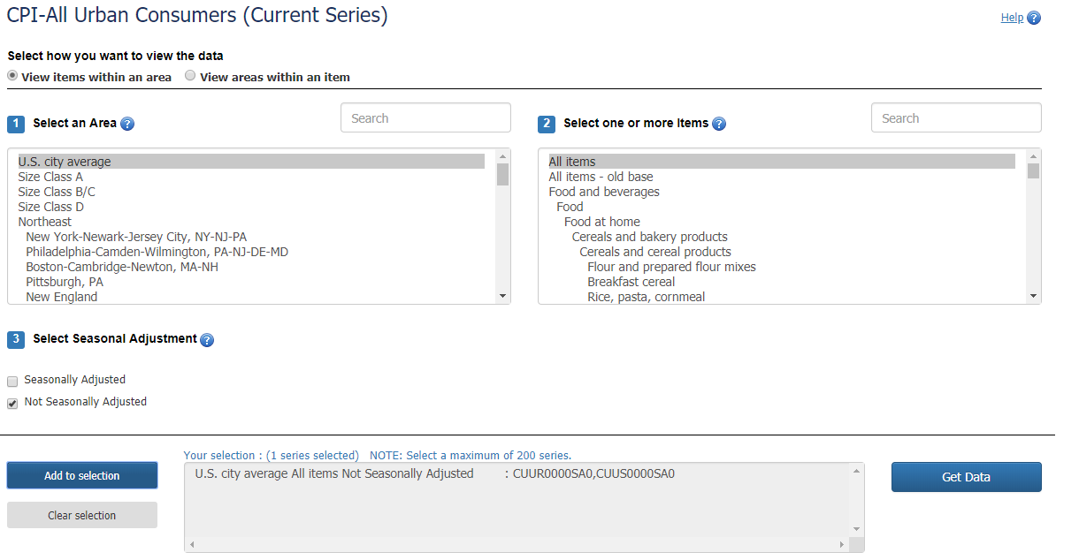
CPI Database Search – All Items
Notes:
In Area 1 we are going to select “US city average” as we did before.

Slide 27
CPI Database Search – All Items
Notes:
In Area 2 we are going to select “All items.” Notice that this is at the very top of the selection list, unlike the “Other goods and services” which was near the bottom.

Slide 28
CPI Database Search – All Items
Notes:
In Area 3, we want to make sure we uncheck “Seasonally Adjusted” because our clause refers to “not seasonally adjusted.”

Slide 29
CPI Database Search – All Items
Notes:
Then, still in Area 3, we want to click on the “Add to selection” button.

Slide 30
CPI Database Search – All Items
Notes:
Clicking on the “Add to selection” button populates the middle box, which until now was blank. Notice again that the title of the report lists the selections we made previously.

Slide 31
CPI Database Search – All Items
Notes:
Finally, we’ll click on the “Get Data” button to run our report.

Slide 32
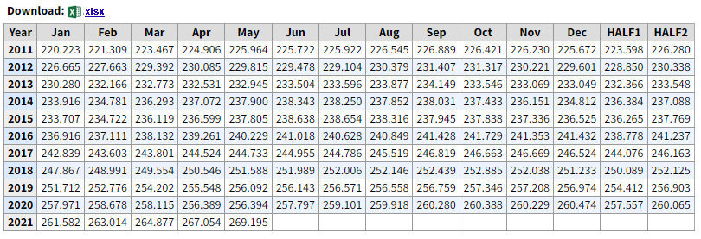
12 Month Percentage Change Formula
Percent Change = [(new value – original value) / original value] * 100
The difference between Month 12 (May 2021) – Month 1 (May 2020), divided by Month 1 (May 2020) * 100
Example
269.195 – 256.394 = 12.801
12.801 / 256.394 = .0499 * 100 = 4.99 OR 5%
The CPI for the most recent twelve-month period not subject to revision is 5%.
Notes:
Our formula is the same as it was before, that never changes. We’re only working with different data. (GO THROUGH SLIDE)

Slide 33
PPI – All Commodities

Slide 34
PRICE ADJUSTMENTS – LIMITED BY PPI (JAN 2006)
Upon request and adequate justification, the Procurement Officer may grant a price increase up to, but not to exceed, the unadjusted percent change for the most recent 12 months for which data is available, that is not subject to revision, in the Producer Price Indexes (PPI) for the applicable commodity, as determined by the Procurement Officer. The Bureau of Labor and Statistics publishes this information on the web at www.bls.gov (.) [07-7B180-1]
*Based on when the price increase request is made by the vendor.
Notes:
Here is our standard PPI clause with the parts that are important to our task highlighted.
Unadjusted percent change.
Most recent 12 months
Not Subject to revision.
Applicable commodity as determined by the procurement officer.
This last one is important and we’ll talk about it more later, but for the process we are using right now, it isn’t relevant.

Slide 35
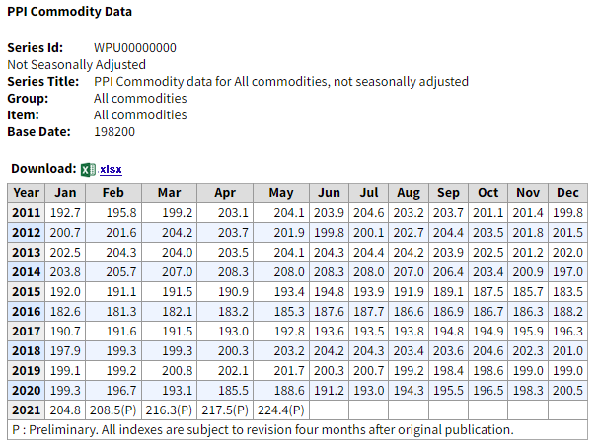
Provisional Data
Notes:
The PPI Table 9 is the equivalent of the CPI Table 7. However, the PPI Table 9 uses components that are contrary to our clause.
Notice that Table 9 is using provisional data which is indicated by the “(P)” designator within the cell.
We will NOT use Table 9 for PPI calculations.

Slide 36
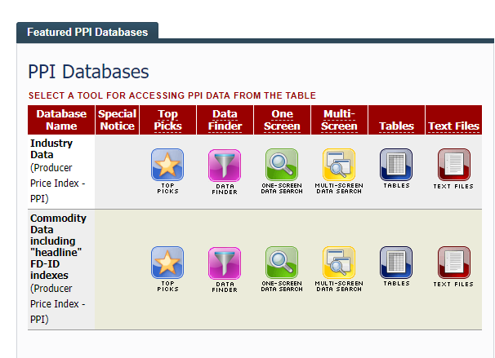
PPI – All Commodities
https://www.bls.gov/ppi/
Notes:
Using the link on the slide, we’re going to locate the PPI databases. This picture may not be right at the top of the linked page, so you may have to scroll up/down to find it.
Once you find it, select the “One-Screen Data Search” button for the COMMODITY data, not the industry data.

Slide 37
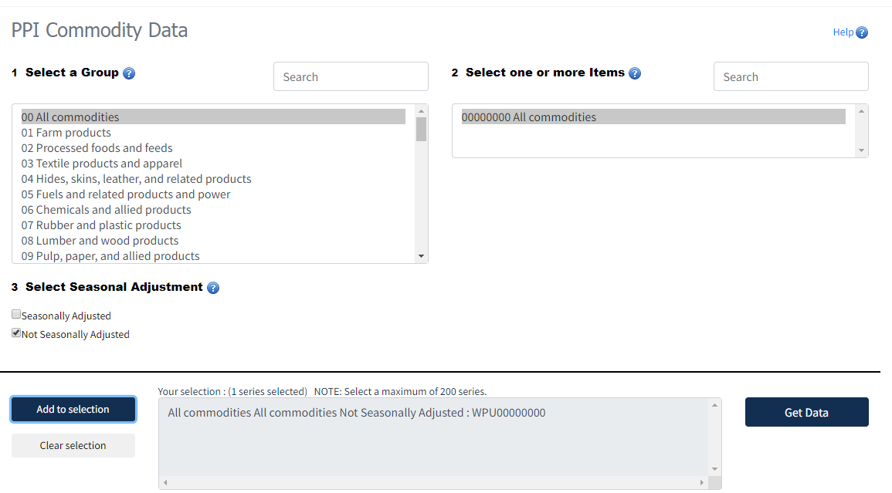
PPI - All commodities
Notes:
As you can see, the “All commodities” is the first item in Area 1, so we will select that.

Slide 38
PPI - All commodities
Notes:
Then we’ll select “All commodities” in Area 2 since it is our only option.

Slide 39
PPI - All commodities
Notes:
We’re going to uncheck the “Seasonally Adjusted” box since we only want the not seasonally adjusted data.

Slide 40
PPI - All commodities
Notes:
Once we have the data set we want, we’ll click the “add to selection” button to populate the middle box on the page.

Slide 41
Copy/Printer Paper
Notes:
Once again, the box gives us the selections we made to get to the report that we want.

Slide 42
PPI - All commodities
Notes:
Once we have what we need, we’ll click on the “Get Data” button to get our data.

Slide 43
PPI - All commodities
Preliminary data does not meet the requirements of any of our clauses.
Notes:
Here is the PPI table we requested. Notice that the header information is similar to the CPI data we saw earlier.
Look at the values for February 2021 through May 2021. There is a “(P)” in each one of those blocks and the explanation is in the black square block on the bottom. These figures are subject to revision for up to four months after original publication.
Going back to our clauses, they clearly state “most recent 12 months for which data is available, that is not subject to revision” so we can’t use any data that is subject to revision.

Slide 44
PPI - All commodities
Percent difference equals the difference between Month 12 (Jan 2021) – Month 1
(Jan 2020), divided by Month 1 (Jan 2020) *100
Example
204.8 – 199.3= 5.5
5.5 / 199.3 = .0276 *100 = 2.76 OR 2.8%
The PPI for the most recent twelve-month period not subject to revision is 2.8%.
Notes:
To meet the requirements of our clause, we have to use the data from January 2020 to January 2021 since those are the most recent data not subject to revision.
Once again, our formula is the same as we used in our CPI calculations.

Slide 45
PPI – Specific Commodities
Copy/Printer Paper

Slide 46
PPI – Specific Commodities
https://www.bls.gov/ppi/
Notes:
Using the link on the slide, we’re going to locate the PPI databases. This picture may not be right at the top of the linked page, so you may have to scroll down to find it.
Once you find it, select the “One-Screen Data Search” button.

Slide 47
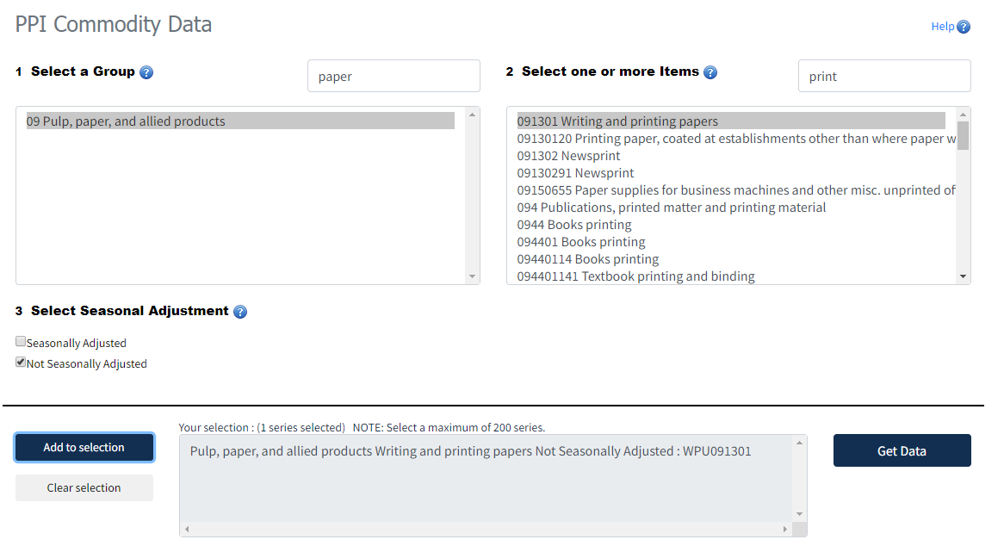
PPI – Specific Commodities
Copy/Printer Paper
Notes:
Here is a step that is different than with the CPI. Here we are using the search utility to narrow our search to find our paper products. Once we entered the search term, the Area 1 moved the search results down to the first instance (and only in this case) of paper.

Slide 48
PPI – Specific Commodities
Copy/Printer Paper
Notes:
Once in paper, we narrowed our search to the commodity that was closest to what we were searching for. Once we selected this, the list in Area 2 was narrowed to include all reports

Slide 49
PPI – Specific Commodities
Copy/Printer Paper
Notes:
Here we’ve selected the “Writing and printing papers” data. We searched for “copy” and that did not result in any hits. We then searched “print” and you can see the number of results we received. After scrolling through all these options, the “best fit” for our contract is the “Writing and printing papers” category.

Slide 50
PPI – Specific Commodities
Copy/Printer Paper
Notes:
We’re going to uncheck “Seasonally Adjusted” since we only want the not seasonally adjusted data.

Slide 51
PPI – Specific Commodities
Copy/Printer Paper
Notes:
Once we have the data set we want, we’ll click the “add to selection” button to populate the middle box on the page.

Slide 52
PPI – Specific Commodities
Copy/Printer Paper
Notes:
Once again, the box gives us the selections we made to get to the report that we want.

Slide 53
PPI – Specific Commodities
Copy/Printer Paper
Notes:
Once we have what we need, we’ll click on the “Get Data” button to get our data.

Slide 54
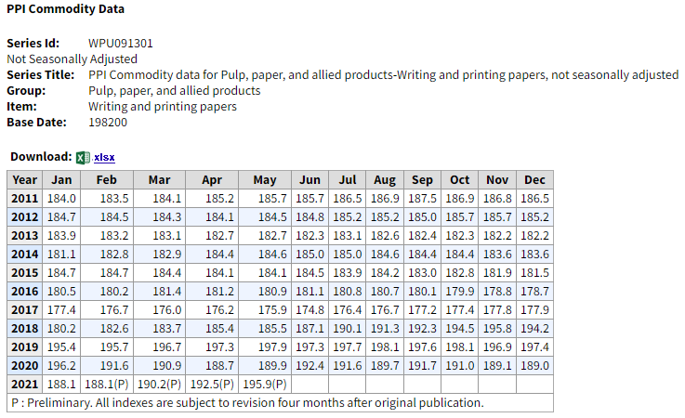
PPI – Specific Commodities
Preliminary data does not meet the requirements of any of our clauses.
Notes:
Here is the PPI table we requested.
Look at the values for February 2020 through May 2021. There is a “(P)” in each one of those blocks and the explanation is in the black square block on the bottom. These figures are subject to revision for up to four months after original publication.
Going back to our clauses, they clearly state “most recent 12 months for which data is available, that is not subject to revision” so we can’t use any data that is subject to revision.

Slide 55
PPI – Specific Commodities
Percent difference in the PPI equals the difference of Month 12 (Jan 2021) – Month 1
(Jan 2020), divided by Month 1 (Jan 2020) *100
Example
188.1 – 196.2 = -8.1
8.1 / 196.2 = .0413 *100 = 4.13 OR -4.13%
The PPI for the most recent twelve-month period not subject to revision is -4.13%.
Notes:
To meet the requirements of our clause, we have to use the data from August 2018 to August 2019 since those are the most recent data not subject to revision.
Once again, our formula is the same as we used in our CPI calculations. You’ll notice in this case the difference is a negative number which indicates the market decreased instead of increasing.

Slide 56
Applying Percent Changes
The current unit price for the product or service is multiplied by the
percent change with the result being the new unit price.
For example:
Current Unit Price: $100
Percent Change: 2.5%
Two Methods to Calculate (Either works with any set of numbers)
1. (Unit Price X % Change) + Current Unit Price = New Unit Price
(100 X .025) = 2.5 + 100 = $102.50
2. Unit Price X 1. % Change = New Unit Price
100 X 1.025 = $102.50
Another Example
Current Unit Price: $.1234
Percent Change: 1.8%
.1234 X 1.018 = $.1256
Notes:
The current unit price may not be expressed as a whole number, it may be expressed as a multiple digit after the decimal point (fuel) which can change the actual amount of the increase.

Slide 57
Things to Consider
Prior to publishing:
Which one to use (CPI/PPI)?
Is there a PPI commodity for your product?
Are there other indexes available?
Are there other methods based on the commodity?
Do you need a price adjustment index at all?
Notes:
Prior to publishing your solicitation, you should consider the following:
Which the most acceptable to use, the CPI or PPI? That depends on your product/service but you need to research this before you publish.
Is there a PPI index for the product you are purchasing? We have seen some instances when there was no PPI for a contract that was awarded, so you don’t want to make that discovery when the contract is already in place. Can we specify which index we will use on the contract? Yes, however, the BLS retires indexes from time to time and you wouldn’t want to be in year four of a contract and the index you based your adjustments off of is no longer valid.
Are there indexes outside the CPI/PPI that are specific to your market that would be a better gauge for your product/service? We learned, the hard way, that the CPI All Items is not a good index to use for adjustments on fuel contracts.
Are there other methods that would better support the market for that particular product? If so, you’ll need to modify one of the price adjustment clauses to indicate which index will be used.
Do you need a price adjustment clause at all? If you are doing a one-time purchase you shouldn’t need a price adjustment clause.

Slide 58
Consolidated Links
CPI Other Goods & Services Table 7 (PDF Newsletter)
https://www.bls.gov/cpi/news.htm
Select “PDF” and scroll down to Table 7
CPI Other Goods & Services Table 7 (HTML)
https://www.bls.gov/news.release/cpi.toc.htm
Select the link to Table 7
CPI Database (One-Screen Data Search)
https://www.bls.gov/data/
Select the ‘One Screen” link under “All Urban Consumers (Current Series)”
PPI Table 9 (All Commodities – PDF) Use for researching a particular commodity.
https://www.bls.gov/web/ppi/ppitable09.pdf
The “All commodities” data should be at the top of the page.
PPI Database (One-Screen Data Search)
https://www.bls.gov/ppi/
Select the “One Screen” link under “Commodity Data”
Percentage Calculators (Helpful for doing percentage calculations)
https://www.omnicalculator.com/collections/percentage
Link to ALL BLS Databases
https://www.bls.gov/data/

Slide 59
Questions?

