Slide 1
Risk Analysis & Management
March 19, 2023
Notes:
© Copyright PresentationGO.com – The free PowerPoint and Google Slides template library

Slide 2
What is Risk?
Possibility of loss or injury
Something or someone that creates or suggests a hazard
Notes:
© Copyright PresentationGO.com – The free PowerPoint and Google Slides template library

Slide 3
Why do I care?
All contracts have some level of risk
Goal is to establish contracts with an acceptable level of risk
Increase the positives
Decrease the negatives
Notes:
We have contracts as a way to manage the risk. Without risk issues, we would have scope of work and payment. The terms and conditions in a contract are how risk is addressed for the buyer and the seller.
Different contracts have different levels of risk.
What does a buyer need to do? – go to next slide
© Copyright PresentationGO.com – The free PowerPoint and Google Slides template library

Slide 4
Risk Analysis
Identification
Probability
Impact
Management
Notes:
For each contract, buyer should perform a risk analysis:
What this is –
We have resources on our website – www.procurement.sc.gov – under Legal → Standard Clauses & Provisions under Risk Analysis and Limiting Contractors Liability
© Copyright PresentationGO.com – The free PowerPoint and Google Slides template library

Slide 5
Identification
Be a pessimist
What could go wrong & how?
It’s not all on you
Procurement isn’t the expert on the product/service – ask the end user
Risk can exist in multiple areas
Notes:
What’s the worst that can happen?
See next page for examples
© Copyright PresentationGO.com – The free PowerPoint and Google Slides template library

Slide 6
Examples of Risk
Vendor risk
Can vendor perform?
Market risk
Do supply chain issues exist?
Product/Service risk
Is the product/service dangerous?
Procurement/Contract Risk
Do specifications meet end user needs?
Has adequate competition occurred?
Are there funding issues?
Are terms and conditions sufficient?
Notes:
Work isn’t done; have to pay another vendor to complete
Can delivery times be met?
Janitorial – Slip & Fall
IT – System isn’t implemented in a timely manner
Cost Overruns
Loss of Funding
© Copyright PresentationGO.com – The free PowerPoint and Google Slides template library

Slide 7
Probability
How likely is the risk?
This Photo by Unknown Author is licensed under CC BY
Notes:
Crystal Ball
Janitorial – will they forget to take out the trash? Will a toxic cleaner be used? Will an unsuitable employee be hired?
© Copyright PresentationGO.com – The free PowerPoint and Google Slides template library

Slide 8
Impact
What is the result?
Notes:
What is the ripple effect?
How bad will it be?
Data Breach on LMS for Procurement Services does not have the same impact as a data breach for Electronic Health Records System at a University

Slide 9
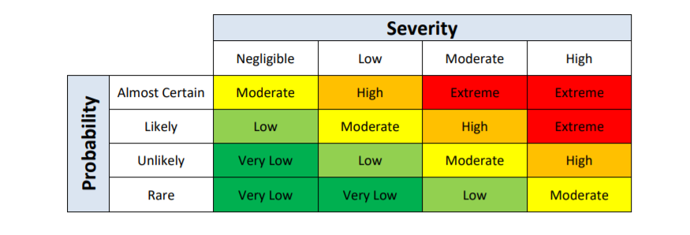
Probability + Impact = Risk Level Table
Notes:
Once all the elements are identified and categorized – put them in the table
Then you need to how to address each risk.

Slide 10
How to manage risk?
Assume
Eliminate
Mitigate
Insure
Transfer
Notes:
These are all business decisions. There is not a one size fits all solution.

Slide 11
Example
Robert Stewart Craig, III
Teenage Driver
Notes:
Walk through a real-life example

Slide 12
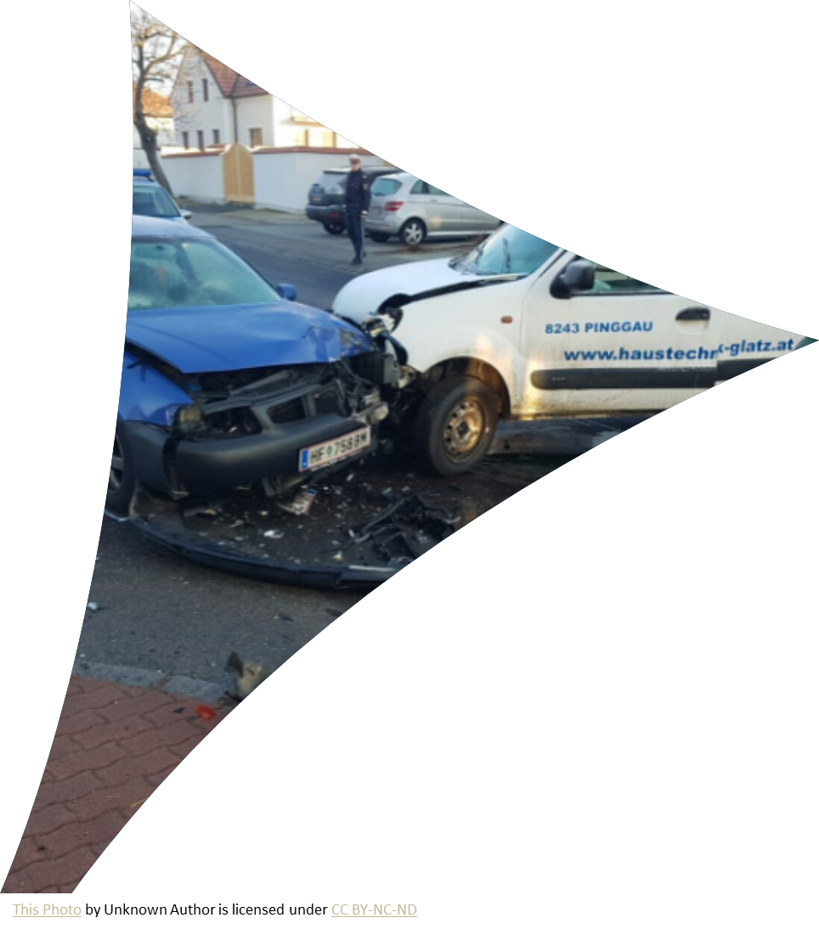
Identification Probability Impact
Notes:
Identify - What are some risks for a teenage driver;
Accident, damage car, damage another car, injuries (himself & others); speeding ticket, increased fuel & insurance costs; I don’t know where he is or what he’s doing or who he’s with
Probability – Will it happen:
Some are more likely than others
Impact – What is the result:

Slide 13
Eliminate
Buy him a bike
Drive him myself
Ride with friends
Notes:
Often the easiest but not the most practical
We live in Calhoun County – not close enough to bike to school
I’m not an Uber driver
Friends live all over – see Calhoun County above
But depending on the contract – you may decide not to pursue some options in the contract

Slide 14
Mitigate
Seatbelts
Driver training
Old car
Notes:
Mitigate – make less severe, serious, or painful
Liquidated damages - To be enforceable, liquidated damages cannot be a “penalty,” but rather a reasonable cover of the estimated costs of the delay/damage to the State, as determined at the time of contracting. Service credits in a service-level agreement are a form of liquidated damages that are sometimes used in IT service contracts: if the contractor fails to maintain a specified service level, the agency would be entitled to a service credit.

Slide 15
Insure
This Photo by Unknown Author is licensed under CC BY-ND
Notes:
Self explanatory
Insurance levels will depend on the amount of risk – again NOT A ONE SIZE FITS ALL – there is no standard. The amounts in the standard clauses may be too little, too much, or just right. They also list all types of insurance which may not be needed – auto insurance on a promotional supplies contract
What is the potential loss? – the insurance amount should match that
Insurance (especially cyber) can be expensive and can result in paying higher prices
Bonds come into play here
Performance bonds. Performance bonds include completion bonds and indemnity bonds. Performance bonds do not ensure a contractor’s performance, but they do provide a reliable source of funds if a contractor cannot perform due to its lack of funds

Slide 16
Transfer
Make him responsible
This Photo by Unknown Author is licensed under CC BY-NC-ND
This Photo by Unknown Author is licensed under CC BY
Notes:
Make him responsible for getting insurance, buying the cart, etc.
Historically, our contracts have put all the risk on the contractor. Vendors don’t like that.
Limitations of liability clause. “Limitation of liability” clauses are risk allocation devices that impose limits on the liability of a contractor (and the agency). Because they limit a contractor’s liability, they should rarely be used, and only in limited circumstances, such as contracts for software licensing and complex IT services such as cloud-based services or software development. Limiting liability may encourage otherwise reluctant vendors—particularly larger and more sophisticated IT firms—to bid on a solicitation. Use caution and consult upper management and legal counsel before including one in a solicitation. For more information, see the Division’s “Basic Guidelines for Using Limitation of Liability Clauses in Complex Information Technology Contracts.”

Slide 17
Assume
Let him drive
Xanax
Yoga
Notes:
After I’ve done all I can – I have to accept the remaining risk

Slide 19
Notes:
© Copyright PresentationGO.com – The free PowerPoint and Google Slides template library

